Slide 1
NEO4J CYPHER TUTORIAL WITH PYTHON
Introduction To Neo4j Graph Alogorithms
Tutorial 72

Slide 2
What is GRAPH ALGORITHM
Definition
Graph algorithms are used to compute metrics for graphs, nodes, or relationships
Example shortest path between two cities
Epidemic propagation , current corona virus situation
Clustering same types(users with same behaviour)

Slide 3
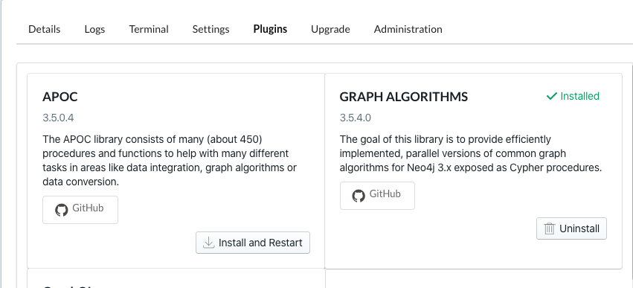
How to install Graph algorithm plugin

Slide 4
Verify the installation by running the below : call algo.list()
How to install Graph algorithm plugin

